Slide 1
8255 Interfacing

Slide 2
Interfacing ADC to 8086 Through 8255

Slide 3
Interfacing ADC with 8086
In most of the cases, the PIPO 8255 is used for interfacing the analog to digital converters with microprocessor.
The analog to digital converters is treaded as an input device by the microprocessor, that sends an initializing signal to the ADC to start the analogy to digital data conversation process.
The start of conversation signal is a pulse of a specific duration.

Slide 4
Interfacing ADC with 8086 (contn)
The process of analog to digital conversion is a slow process, and the microprocessor has to wait for the digital data till the conversion is over.
After the conversion is over, the ADC sends end of conversion EOC signal to inform the MP that the conversion is over and the result is ready at the output buffer of the ADC.
These tasks of issuing an SOC pulse to ADC, reading EOC signal from the ADC and reading the digital output of the ADC are carried out by the CPU using 8255 I/O ports.

Slide 5
Interfacing ADC with 8086 (contn)
The time taken by the ADC from the active edge of SOC pulse till the active edge of EOC signal is called as the conversion delay of the ADC.
It may range any where from a few microseconds in case of fast ADC to even a few hundred milliseconds in case of slow ADCs.

Slide 6
Interfacing ADC with 8086 (contn)
The available ADC in the market use different conversion techniques for conversion of analog signal to digitals.
Successive approximation techniques and dual slope integration techniques are the most popular techniques used in the integrated ADC chip.

Slide 7
Interfacing ADC with 8086 (contn)
General algorithm for ADC interfacing contains the following steps:
1. Ensure the stability of analog input, applied to the ADC.
2. Issue start of conversion pulse (SOC) to ADC
3. Read end of conversion signal (EOC)to mark the end of
conversion processes.
4. Read digital data output of the ADC as equivalent digital
output.

Slide 8
Interfacing ADC with 8086 (contn)
Analog input voltage must be constant at the input of the ADC right from the start of conversion till the end of the conversion to get correct results.
This may be ensured by a sample and hold circuit which samples the analog signal and holds it constant for a specific time duration.
The microprocessor may issue a hold signal to the sample and hold circuit.

Slide 9
Interfacing ADC with 8086 (contn)
If the applied input changes before the complete conversion process is over, the digital equivalent of the analog input calculated by the ADC may not be correct.

Slide 10
Interfacing ADC with 8086 (contn)
ADC 0808/0809 :
The ADC chips 0808 and 0809 are 8-bit CMOS, successive approximation converters.
This technique is one of the fast techniques for analog to digital conversion.
The conversion delay is 100μs at a clock frequency of 640 KHz, which is quite low as compared to other converters.

Slide 11
Interfacing ADC with 8086 (contn)
These converters do not need any external zero or full scale adjustments as they are already taken care of by internal circuits.
These converters internally have a 3:8 analog multiplexer so that at a time eight different analog conversion by using address lines - ADD A, ADD B, ADD C.

Slide 12
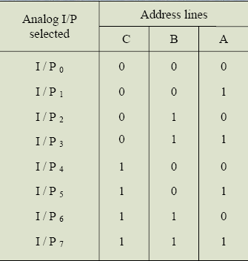
Interfacing ADC with 8086 (contn)

Slide 13
Interfacing ADC with 8086 (contn)
Using these address inputs, multichannel data acquisition system can be designed using a single ADC.
The CPU may drive these lines using output port lines in case of multichannel applications.
In case of single input applications, these may be hardwired to select the proper input.

Slide 14
Interfacing ADC with 8086 (contn)
There are unipolar analog to digital converters, i.e. they are able to convert only positive analog input voltage to their digital equivalent. These chips do no contain any internal sample and hold circuit.

Slide 15
Interfacing ADC with 8086 (contn)
If one needs a sample and hold circuit for the conversion of fast signal into equivalent digital quantities, it has to be externally connected at each of the analog inputs.
Vcc Supply pins +5V
GND GND
Vref + Reference voltage positive +5 Volts max
Vref- Reference voltage negative 0Volts min.

Slide 16
Interfacing ADC with 8086 (contn)
I/P0–I/P7 Analog inputs
ADD A,B,C Address lines for selecting analog
inputs.
O7 – O0 Digital 8-bit output with O7 MSB and
O0 LSB
SOC Start of conversion signal pin
EOC End of conversion signal pin
OE Output latch enable pin, if high enables
Output
CLK Clock input for ADC

Slide 17
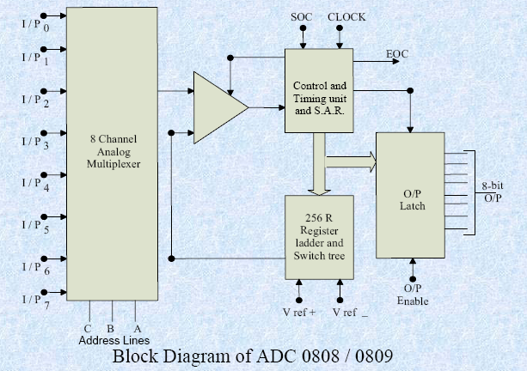

Slide 18
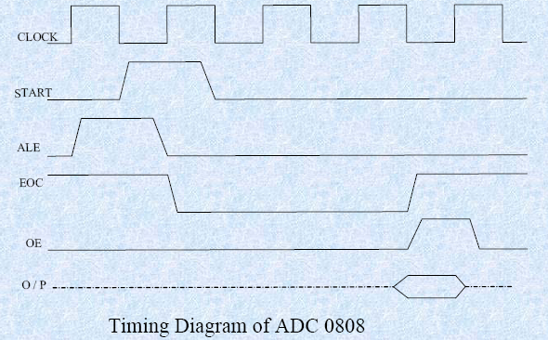

Slide 19
Interfacing ADC with 8086 (contn)
Example:
Interfacing ADC 0808 with 8086 using 8255 ports. Use port A of 8255 for transferring digital data O/P of ADC to the CPU and port C for control signals. Assume that an analog input is present at I/P2 of the ADC and a clock input of suitable frequency is available for ADC.

Slide 20
Interfacing ADC with 8086 (contn)
Solution:
- The analog input I/P2 is used
Therefore address pins A,B,C should be 0,1,0 respectively to select I/P2.
The OE and ALE pins are already kept at +5V to select the ADC and enable the outputs.
Port C upper acts as the input port to receive the EOC signal
while port Clower acts as the output port to send SOC to the ADC.

Slide 21
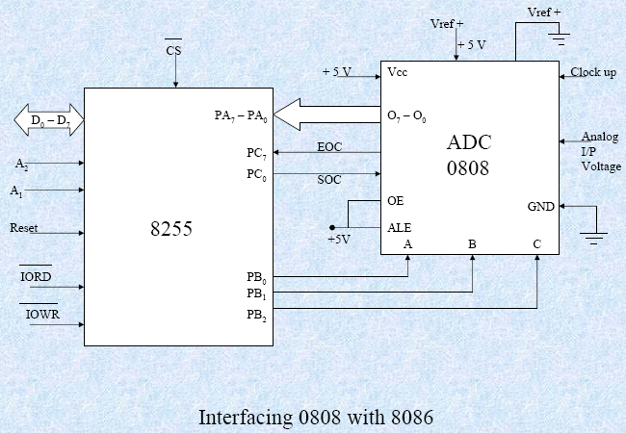

Slide 22
Interfacing ADC with 8086 (contn)
Port A acts as a 8-bit input data port to receive the digital data output from the ADC.
The 8255 control word is written as follows:
D7 | D6 | D5 | D4 | D3 | D2 | D1 | D0
1 | 0 | 0 | 1 | 1 | 0 | 0 | 0

Slide 23
Interfacing ADC with 8086 (contn)
The required ALP is as follows:
MOV AL, 98h ;initialise 8255 as
OUT CWR, AL ;discussed above.
MOV AL, 02h ;Select I/P2 as analog
OUT Port B, AL ;input.
MOV AL, 00h ;Give start of conversion
OUT Port C, AL ; pulse to the ADC
MOV AL, 01h
OUT Port C, AL
MOV AL, 00h
OUT Port C, AL
WAIT: IN AL, Port C ;Check for EOC by
RCR ; reading port C upper and
JNC WAIT ;rotating through carry.
IN AL, Port A ;If EOC, read digital equivalent (in AL)
HLT ;Stop.

